Slide 1


Aga Khan Higher Secondary School Karimabad

Slide 2

Introducing Sync
SYNC is an AI-powered accessibility platform that uses computer vision and machine learning to recognize Pakistani sign language gestures and convert their meaning into understandable text and speech. Its primary objective is to make communication more accessible between sign-language users and people who do not understand sign language and contribute to our culture and arts further.
Team:
M Hasan
Javeria Irfan
Samreen Sikandar

Slide 3
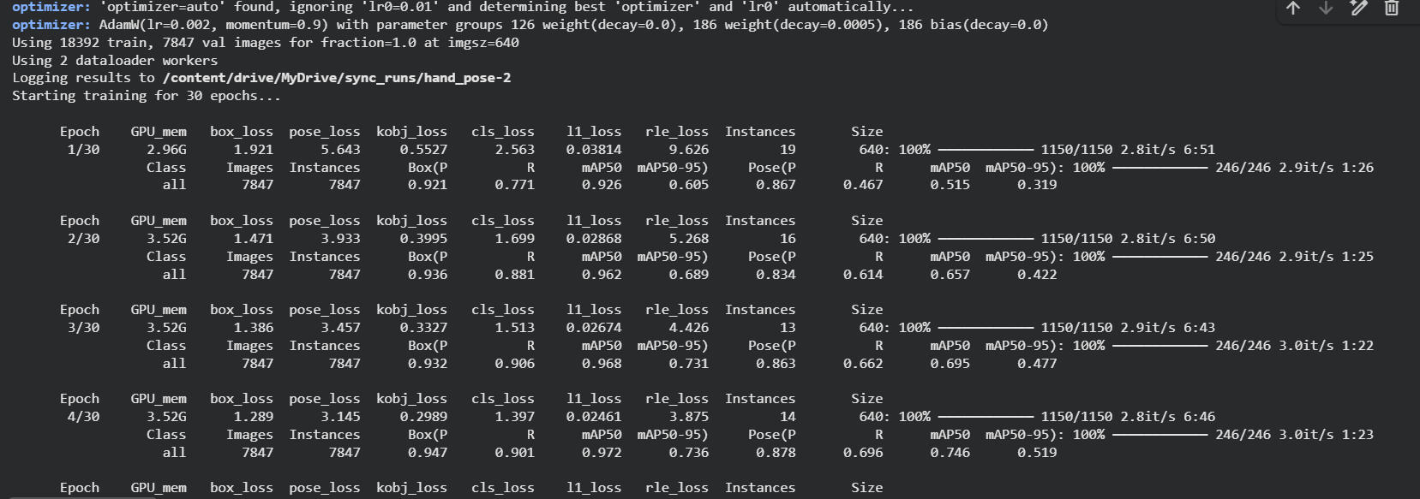
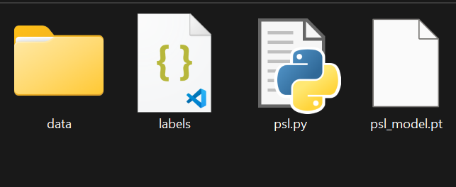
Screenshots

Slide 4
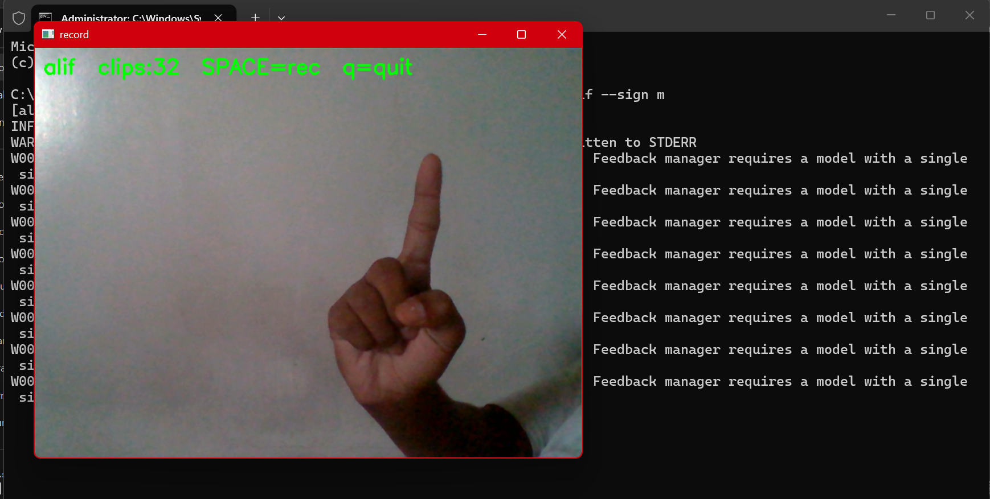
Basic Prototype

Slide 5
The Process and Methodology
Decision making
Selected Pakistani Sign Language
Python As main language
Python program to detect hands
Tested in different lighting
Ultralytics as Deep learning library
Program to feed signs to the model
Development
API Endpoints built
Portable Model
Built real App with our own language and culture
Dataset Feeding
Pakistani Sign Lang Training
Basic Program building
Trained the model on 20,000 Images of hands to track hands
100 Epoche on Colab and Kaggle (Yolo26n-pose)

Slide 6
Project Preparation
To contribute to the deaf and disabled community of Pakistan is our ideology and objective, We believe technology should help the special Individuals around us
We have discovered there are very few sign language translators and ML models, and specifically no one has even tried for Pakistani Sign Language which translates to Urdu and local languages
Our Project combines an Open source Machine learning model YOLO combined with media pipe holistic and Ultralytics which we fed a large dataset (~20,000 Images) of hands to detect hands , every step included careful testing after which we moved towards training it for signs so we developed a program to feed signs which now enables us to introduce sync as our own PSL-to-Speech translator while also open sourcing our API and Model for community of disabled individuals
The Initial risks and difficulties was to find a dedicated high-end Hardware to train the model, which we luckily found on colab and Kaggle and trained it on the large dataset for a whole day after a day of failure

Slide 7
Final Model & Demonstration
Words detection
In-App detection
Web based Detection
Letters detection

Slide 8
Project Evaluation
Successful Objectives Met
Contribution to Disabled community
Low-cost translation tool
First Pakistani Sign Language translator
Support 5+ local languages
Communication made easier
Given away to developer's community for further innovation

Slide 9
Results and Future Scope
Results:
Model working:
Fully Working!
Translates to:
5+ Languages
Including urdu , sindhi and memoni
Sign Languages covered:
Pakistani Only
Cost
#1
Dataset
Almost Free
Pakistani Signs Language translator
1000+ Images and videos of signs
Addition of More Languages
Expanding Dataset
Text To speech in more languages
More API Endpoints with security
Integration with other apps
Future Scope:

Slide 10
Social Impact & Conclusion
With Sync , we can help disabled individuals of the society communicate more efficiently as well as specifically people of Pakistan who have a distinguished sign language which requires special attention while also translating to local languages like Urdu , Pashto , sindhi and still expanding because our culture should be our first. As Pakistan has high number of uneducated, we plan to fine-tune sync into free applications on all platforms for sign-to-speech while also developing further accuracy and speed of model.
To conclude , we have met most of our objectives, but the never-ending race of innovation and curiosity intrigues us to build and scale this further.
Thank You!

